Slide 1
Kubernetes

Slide 2
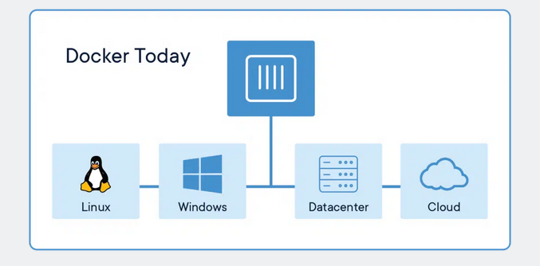
What is a container?
A container is a standard unit of software that packages up code and all its dependencies so the application runs quickly and reliably from one computing environment to another. A Docker container image is a lightweight, standalone, executable package of software that includes everything needed to run an application: code, runtime, system tools, system libraries and settings.

Slide 3

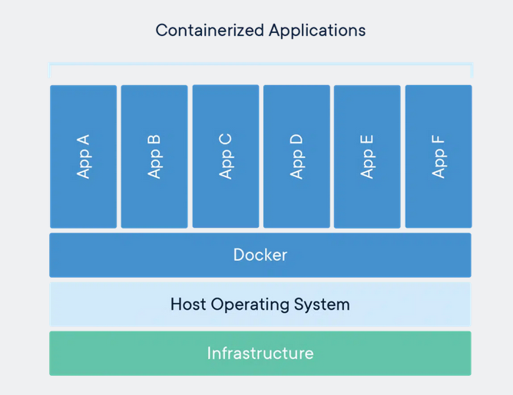
Container images become containers at runtime and in the case of Docker containers – images become containers when they run on Docker Engine.
Available for both Linux and Windows-based applications, containerized software will always run the same, regardless of the infrastructure.
Containers isolate software from its environment and ensure that it works uniformly despite differences for instance between development and staging.

Slide 4
Types
Docker containers that run on Docker Engine:
Standard: Docker created the industry standard for containers, so they could be portable anywhere
Lightweight: Containers share the machine’s OS system kernel and therefore do not require an OS per application, driving higher server efficiencies and reducing server and licensing costs
Secure: Applications are safer in containers and Docker provides the strongest default isolation capabilities in the industry

Slide 5
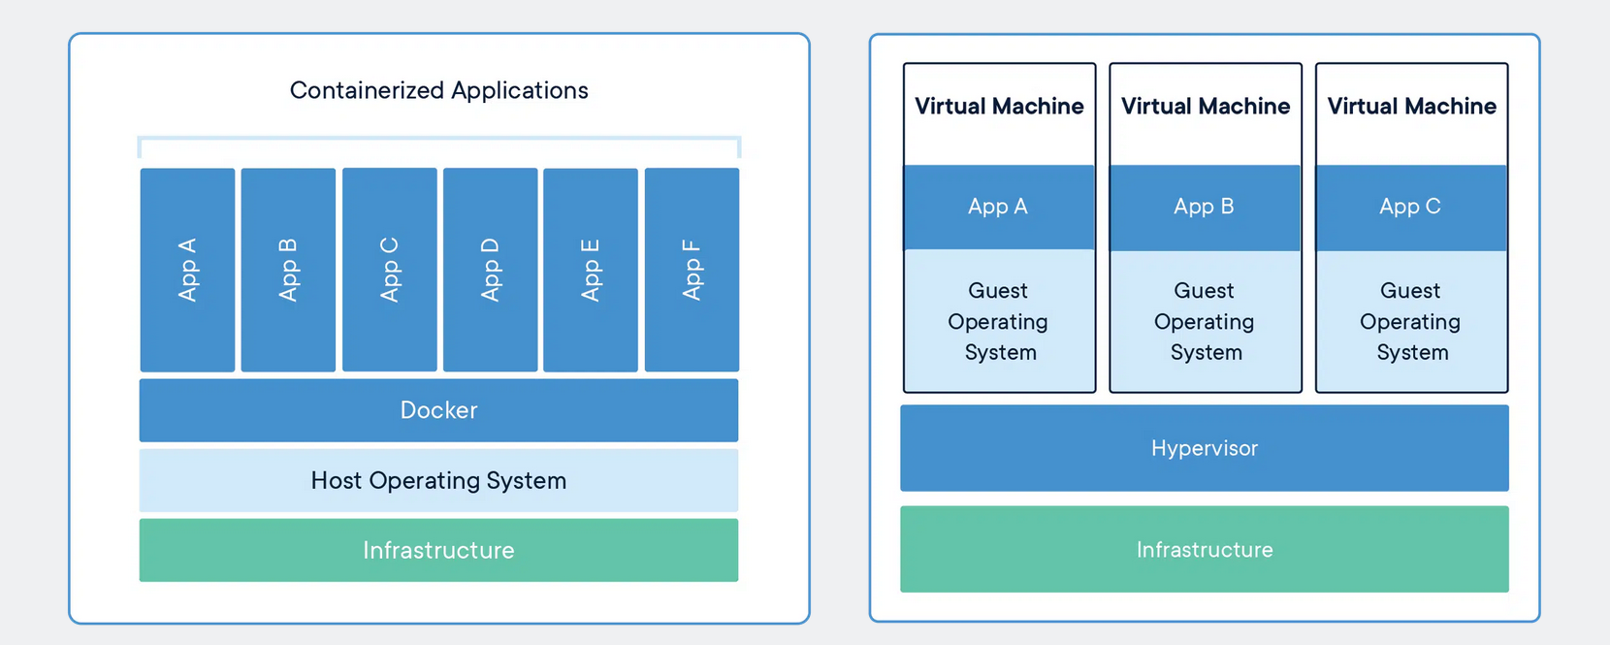
Containers Vs Virtual Machines

Slide 6
What is container orchestration?
Container orchestration is the automation of much of the operational effort required to run containerized workloads and services.
This includes a wide range of things software teams need to manage a container’s lifecycle, including provisioning, deployment, scaling (up and down), networking, load balancing and more.

Slide 7
Why do we need container orchestration?
Because containers are lightweight by nature, running them in production can quickly become a massive effort.
Particularly when paired with microservices—which typically each run in their own containers.
A containerized application might translate into operating hundreds or thousands of containers, especially when building and operating any large-scale system.
This can introduce significant complexity if managed manually.
Container orchestration is what makes that operational complexity manageable for development and operations or DevOps
It provides a declarative way of automating much of the work.
This makes it a good fit for DevOps teams and culture, which typically strive to operate with much greater speed and agility than traditional software team

Slide 8
What are the benefits of container orchestration?
Container orchestration is key to working with containers, and it allows organizations to unlock their full benefits. It also offers its own benefits for a containerized environment, including:
Simplified operations: This is the most important benefit of container orchestration and the main reason for its adoption. Containers introduce a large amount of complexity that can quickly get out of control without container orchestration to manage it.
Resilience: Container orchestration tools can automatically restart or scale a container or cluster, boosting resilience.
Added security: Container orchestration’s automated approach helps keep containerized applications secure by reducing or eliminating the chance of human error.

Slide 9
What is Kubernetes container orchestration?
Kubernetes is a popular open source platform for container orchestration.
It enables developers to easily build containerized applications and services, as well as scale, schedule and monitor those containers.
While there are other options for container orchestration, such as Apache Mesos or Docker Swarm, Kubernetes has become the industry standard.
Kubernetes provides extensive container capabilities, a dynamic contributor community, the growth of cloud-native application development and the widespread availability of commercial and hosted Kubernetes tools.
Kubernetes is also highly extensible and portable, meaning it can run in a wide range of environments and be used in conjunction with other technologies, such as service meshes.
In addition to enabling the automation fundamental to container orchestration, Kubernetes is considered highly declarative.
This means that developers and administrators use it to essentially describe how they want a system to behave, and then Kubernetes executes that desired state in dynamic fashion.

Slide 10
What is multi-cloud container orchestration?
In the most basic sense, the term “multi-cloud” refers to an IT strategy of using two or more cloud services from two or more providers.
In the context of containers and orchestration, multi-cloud usually means the use of two or more cloud infrastructure platforms, including public and private clouds, for running applications.
Multi-cloud container orchestration, then, refers to the use of an orchestration tool to operate containers across multi-cloud infrastructure environments—instead of running containers in a single cloud environment.
Software teams pursue multi-cloud strategies for different reasons, but the benefits can include infrastructure cost optimization, flexibility and portability (including reducing vendor lock-in), and scalability (such as dynamically scaling out a cloud from an on-premises environment when necessary.)
Multi-cloud environments and containers go hand-in-hand because of the latter’s portable, “run anywhere” nature

Slide 11
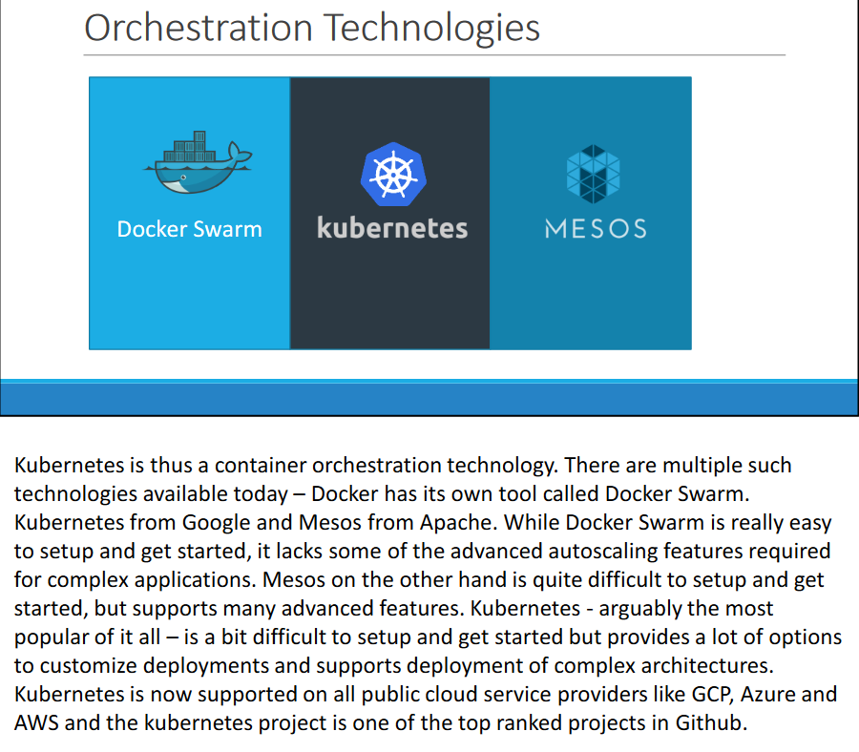
Orchestration Technologies

Slide 12


Slide 13

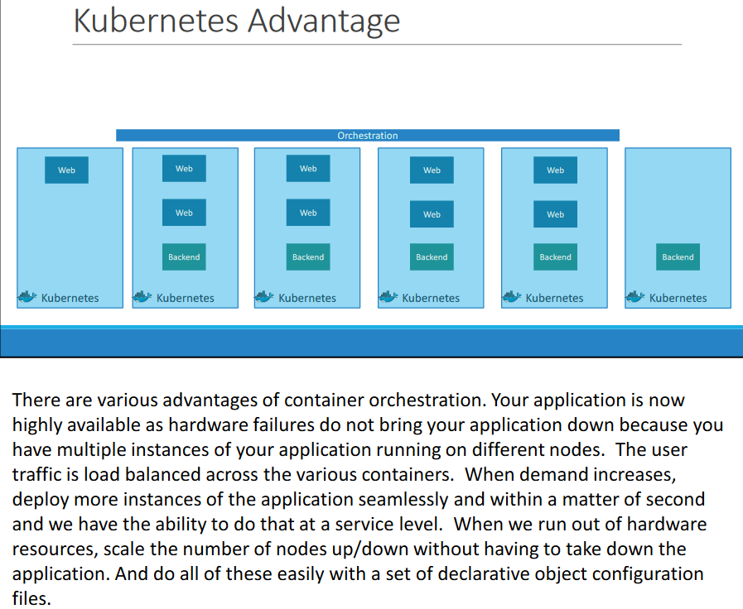

Slide 14
Benefits of Container Orchestration

Slide 15
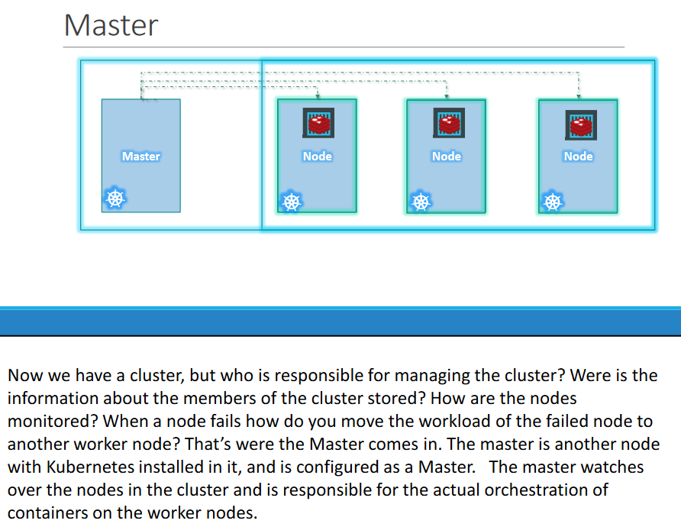
Master : The Resource Manager

Slide 16
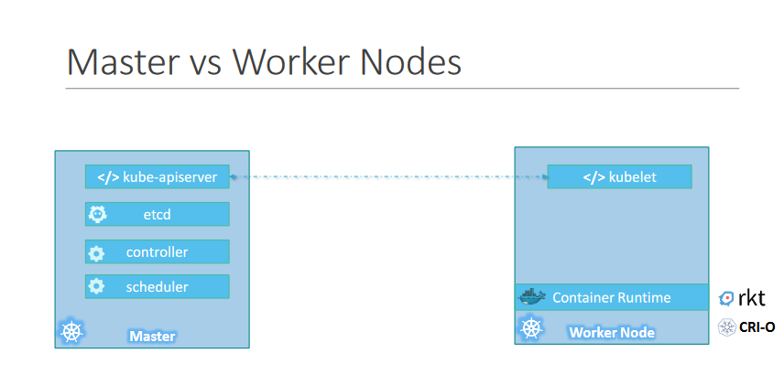

Slide 17
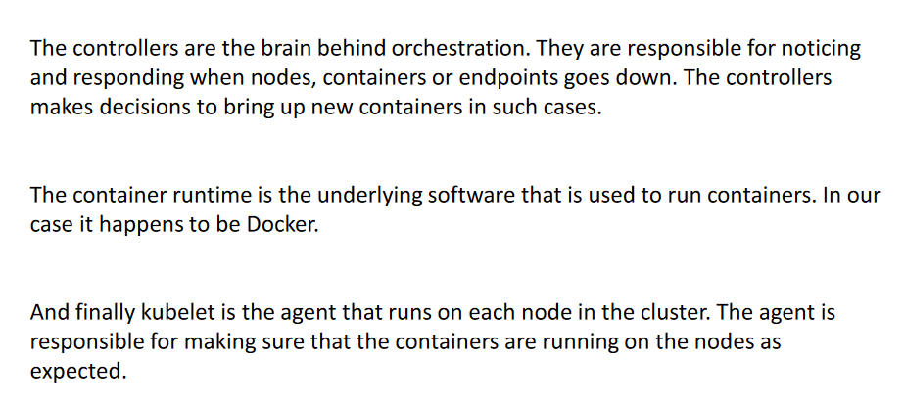

Slide 18
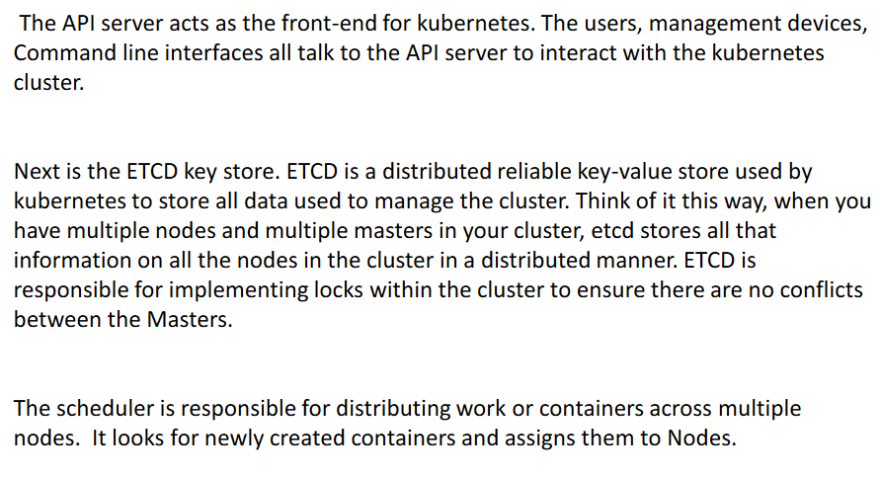

Slide 19
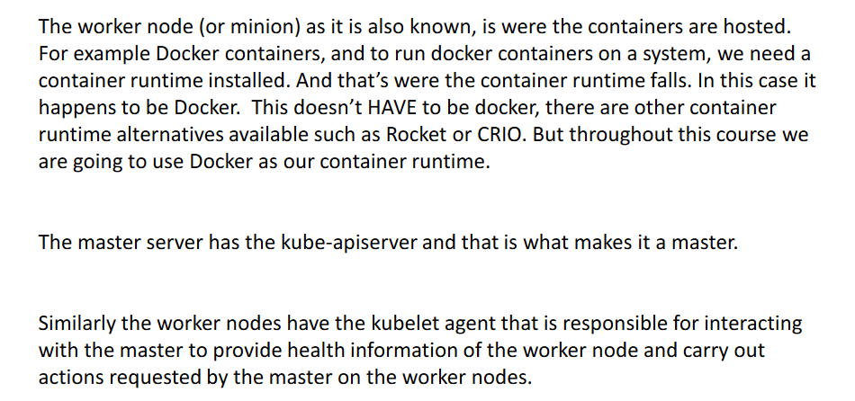

Slide 20
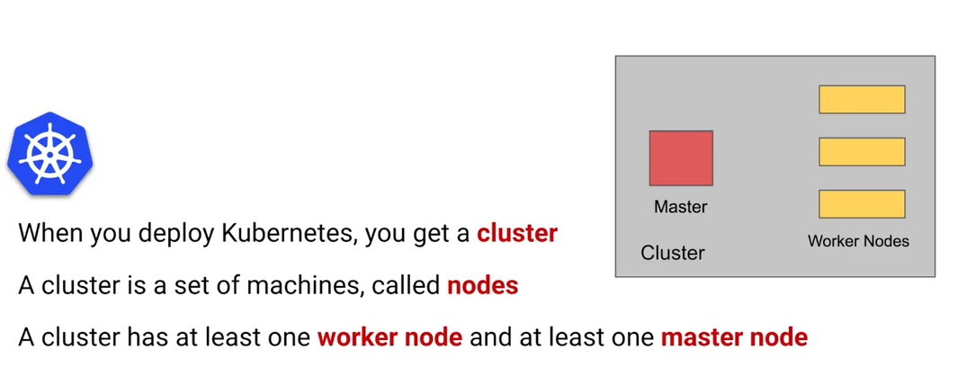
Nodes and Cluster

Slide 21

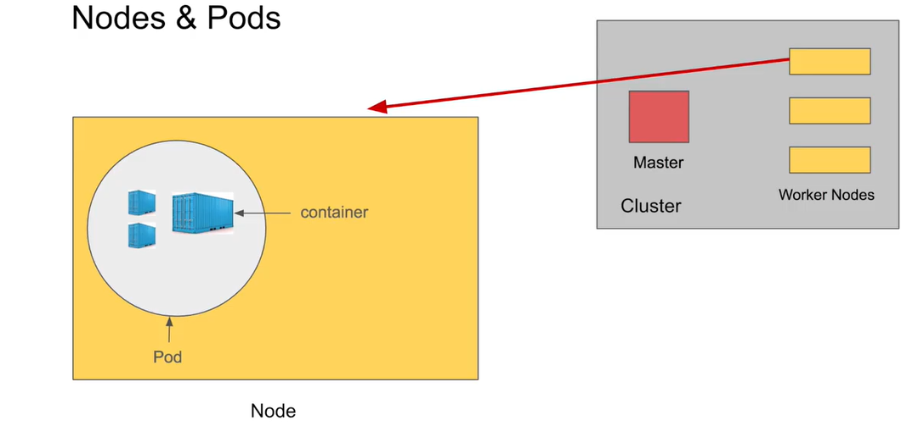

Slide 22
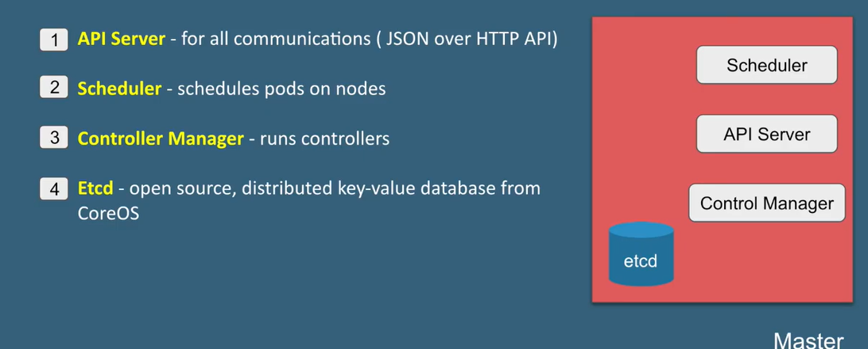
Components of Master Node

Slide 23

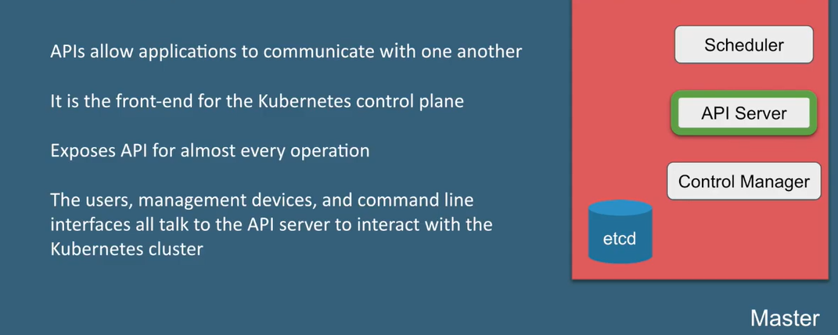

Slide 24

API Server

Slide 25
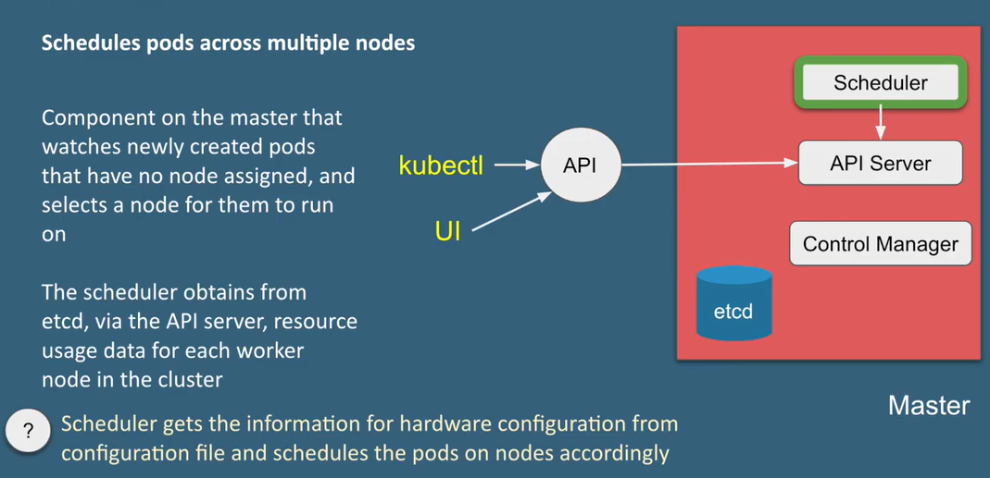
Scheduler

Slide 26
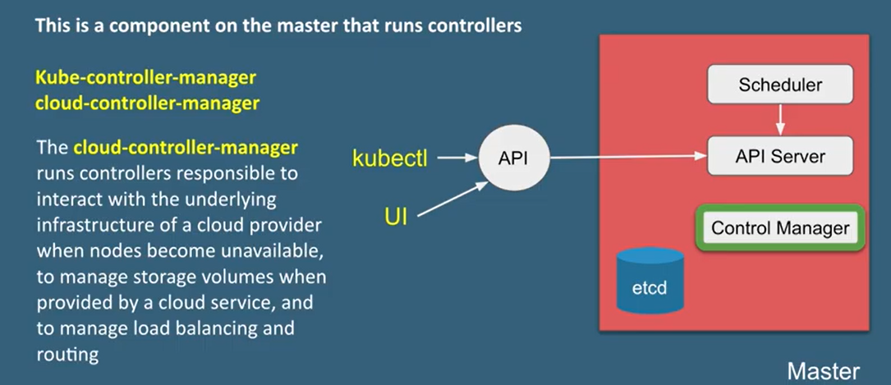
Cloud Control Manager

Slide 27
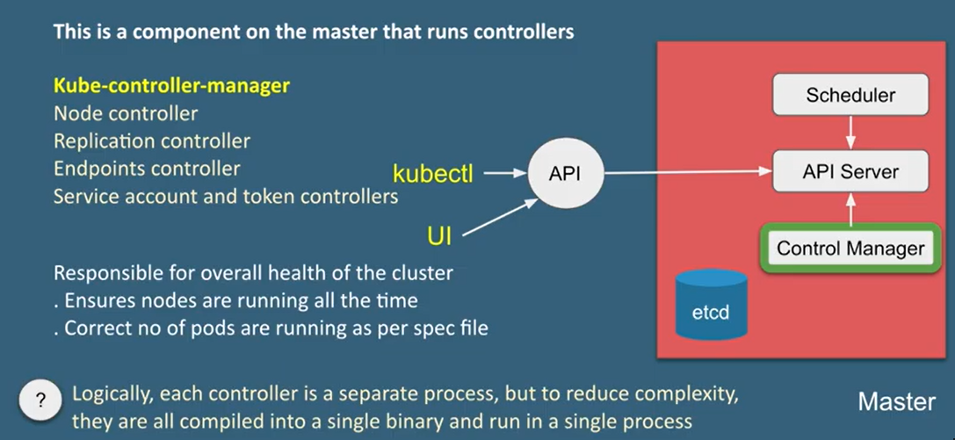
Control Manager

Slide 28

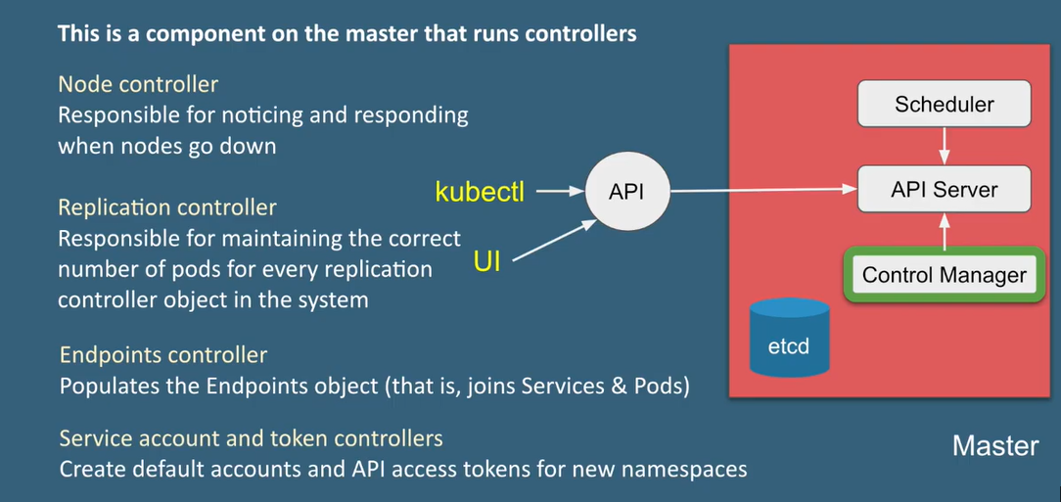

Slide 29
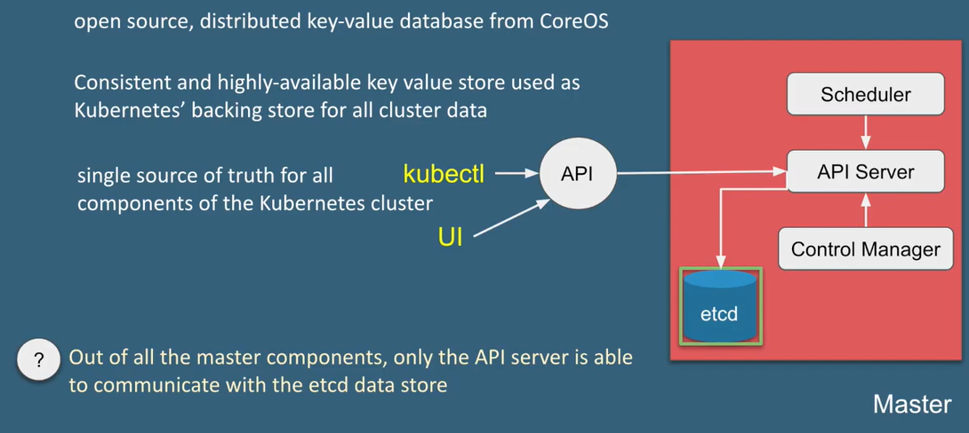
etcd

Slide 30

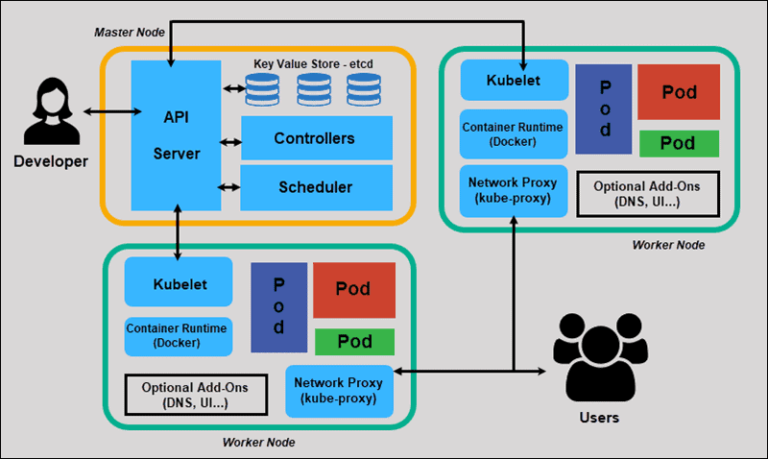

Slide 31
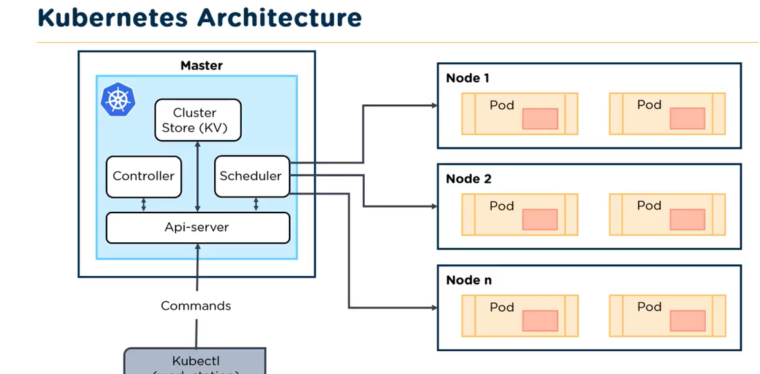

Slide 32
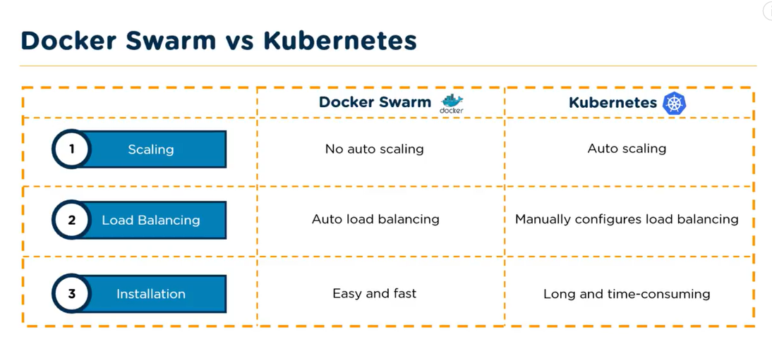

Slide 33
